Slide 1
Basic Buffer Overflow & Bluetooth Vulnerabilities
DBD

Slide 2
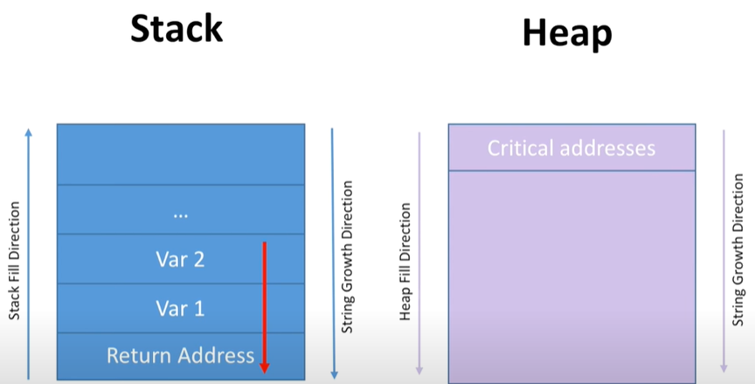
Buffer Overflow Overview
When space is allocated for a resource, but goes unchecked, the script is susceptible to a buffer overflow
Buffer Overflow: More memory is written to space than allocated.
Overflows may result in:
Stack/Heap corruption
Heap: dynamic/global
Stack: local
Errors
Elevation of privilege

Slide 3
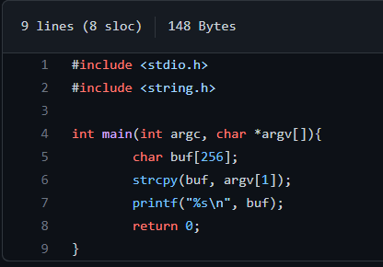
Example: Shell Privilege BO Attack
buf [256]
NOPSLED
Shellcode
Allocation with NO check
Base Pointer
Return

Slide 4
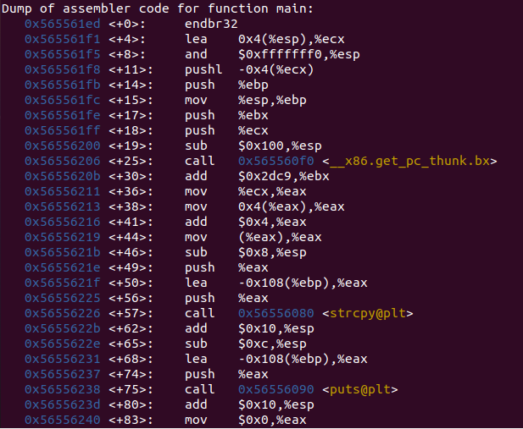
GDB

Slide 5
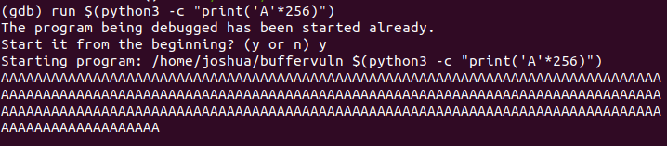
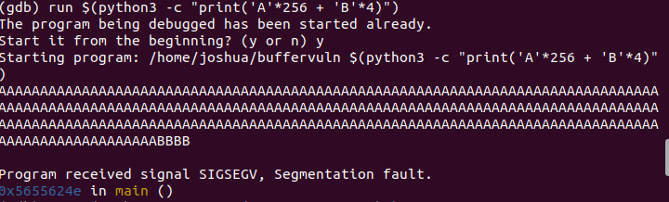
Wrong

Slide 6
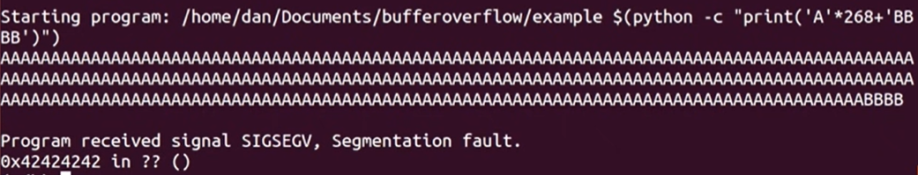
Correct
Shellcode

Slide 7
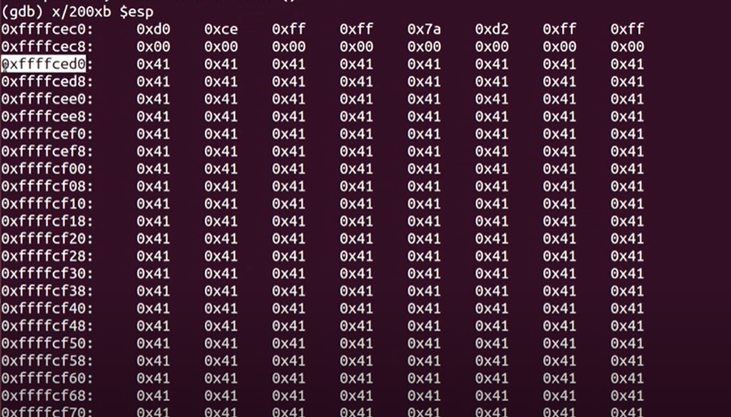

Slide 8
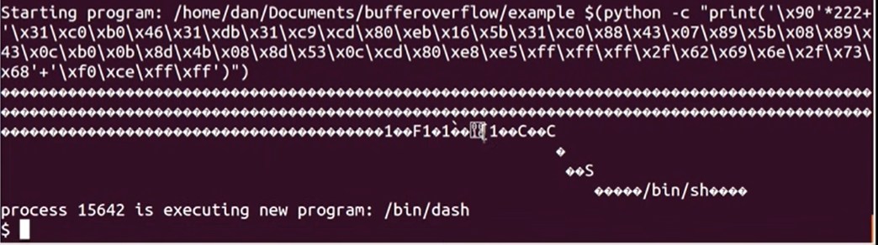
Endiannes

Slide 9
What happened?
256 bytes of buf
4 bytes of return addr
NOP?
Shellcode ~43 bytes
NOP 268-43 = 222 | Shellcode (43) | Return (4)
buf (268) | Return (4)
Why the reference memory point change?
Randomness in Memory
The place you land in the NOPSLED does not matter, you still slide down

